Slide 1
What is an Operating System?
  An operating system is software that enables applications to interact with a computer’s hardware.

Slide 2
Introduction to OS
Computer System Model
Functions of the OS
History of OS

Slide 3
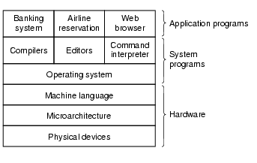
The Computer System

Slide 4
Hardware Level - 3 sublayers
Physical devices
  transistors, gates, ICs, wires, PCBs, CPU, connectors, memory - tangible components from which functional units can be built
See http://www.nobelprize.org/educational/physics/integrated_circuit/history/index.html
Notes:
IC – integrated circuits
PCB – printed circuit board
CPU – central processing unit
See here for inside a PC: http://www.computerhope.com/issues/ch000997.htm

Slide 5
Hardware Level - 3 sublayers
Microarchitecture
  physical devices grouped together to form functional units
  Contains various registers (memory) internal to CPU and the ALU
  CPU defines the Instruction Set of the system
  a typical instruction would have 1 or 2 operands fetched from memory into registers, combined in the ALU to perform some operation, result stored in registers
Notes:
CPU – central processing unit
ALU – arithmetic and logic unit

Slide 6
Hardware Level - 3 sublayers
Machine Language -a software sublayer
  aka Instruction Set Architecture (ISA) level
  based on the underlying hardware + instructions visible to an assembly language programmer
  level where assembly language exists and is very low-level, allowing programs to be written that can control all physical devices.
  Easier than programming in absolute machine code though!
  Contains between 50-300 instructions
  I/O devices are controlled by loading values into special device registers

Slide 7
A “Basic” 8088 Assembly Program
  1 DATA SEGMENT
  2 INPUT1 DW 10
  3 INPUT2 DW 25
  4 INPUT3 DW 8
  5 RESULT DW ?
  6 DATA ENDS
  7 CODE SEGMENT
  8 MOV AX,INPUT1 ; Get 1st number from memory into AX
  9 MOV BX,INPUT2 ; Get 2nd number from memory into BX
  10 ADD AX,BX ; Add together, store result in AX register
  11 MOV BX,INPUT3 ; Get 3rd number from memory into BX
  12 SUB AX,BX ; Subtract from 1st result
  13 MOV RESULT,AX ; Store final answer
  14 CODE ENDS

Slide 8
The Equivalent Program in Java
  public class Calculation{
  public static void main( String args[] )
  {
  int a=10,b=25,c=8,result;
  result=a+b-c;
  }
  }
Be thankful for High-level Programming Languages :-)

Slide 9
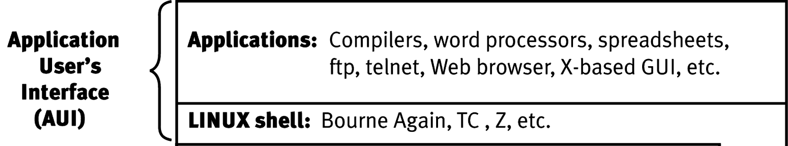
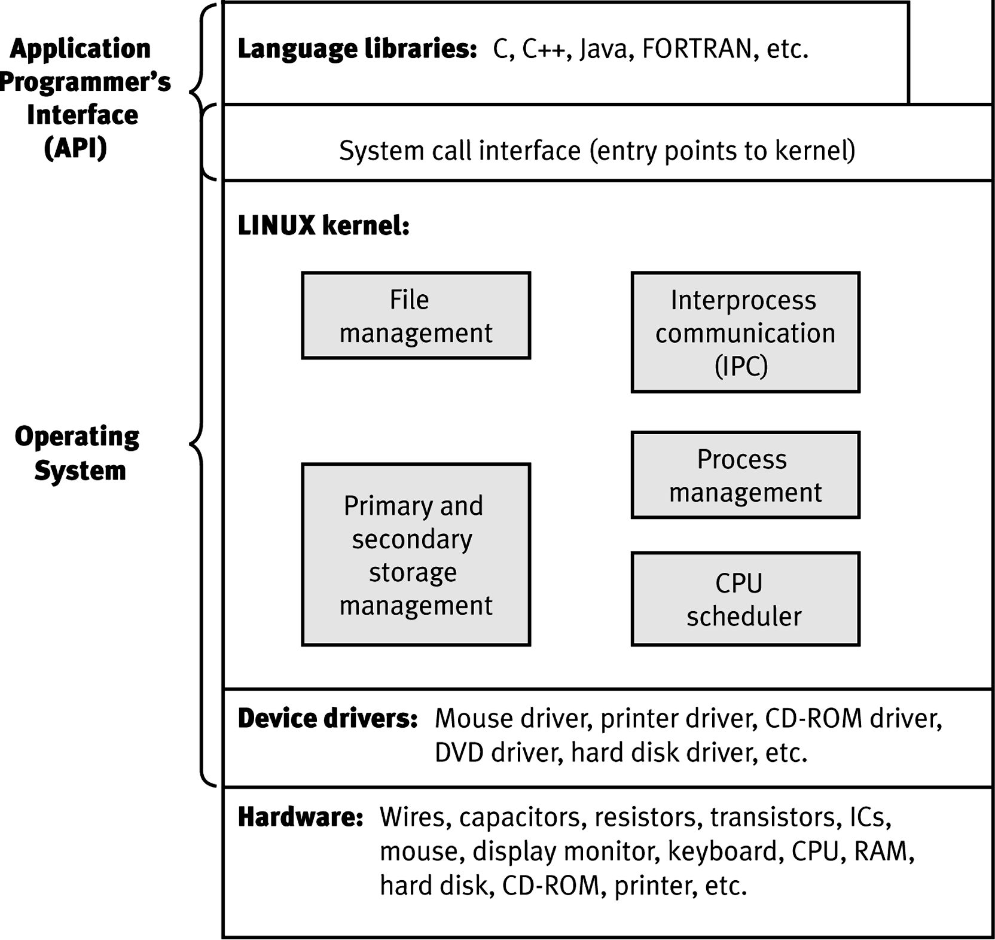
Closer Look at Software Layers for Linux
Notes:
An Application Programming Interface (API) is a particular set of rules and specifications that a software program can follow to access and make use of the services and resources provided by another particular software program that implements that API.
Almost every application depends on the APIs of the underlying operating system to perform such basic functions as accessing the file system.

Slide 10
Operating System Level
Hides complexity associated with hardware layers
Gives the programmer (end-user) a much easier set of instructions to work with (than assembly language)
  user can drag a file to another folder to copy it rather than have to write a long-winded assembly or C program to enable this action to occur.

Slide 11
System software e.g. command interpreter (shell), windows systems, language libraries, compilers and editors lie atop the OS layer - these are strictly not part of the OS although typically bundled with it to complement their use.

Slide 12
Kernel Mode vs. User Mode
The OS runs in kernel mode (aka supervisor mode)
  It can execute any of the available machine instructions
  It has complete access to all the hardware
  All of memory is accessible
All other software – systems software and applications - run in user mode
  only a subset of the machine instructions are available
  In particular instructions that do I/O are forbidden to user-mode programs
  Certain areas of memory protected from user access

Slide 13
Application Programs Level
Programs obtained or written by the user to solve their particular problems
  word processors
  spreadsheets
  WWW browsers
  Java development environment
  DBMS

Slide 14
What are the goals of an OS?
Hide complexity of the underlying hardware layers as mentioned already
  the end-user is presented with an easy to use interface - a virtual machine - which abstracts all the real complexity issues saving the user huge time and energy. This virtual reality is achieved through system calls.
Managing system resources
  provide orderly, fair, controlled access to the CPU, memory, I/O devices etc. among programs

Slide 15
What are the goals of an OS?
Reliability of OS is often forgotten as being an important function, especially so for servers in business - a system that crashes on a regular basis is usually not very well designed

Slide 16
The Operating System as a Resource Manager
Allow multiple programs to run at the same time
Manage and protect memory, I/O devices, and other resources
Includes multiplexing (sharing) resources in two different ways:
  In time
  In space

Slide 17
Time & Space Multiplexing of System Resources
Time multiplexing means different programs or users take turns using a resource
  a single CPU needing to run multiple programs
    how long will each program get?
    Which goes next?
    Each job can be interrupted
  a single printer being shared over a network
    which job will be printed next
    job completed as a batch

Slide 18
Time & Space Multiplexing of System Resources
Space multiplexing means all programs or users get a portion of the resource
  main memory divided up among several running programs, each one being resident concurrently
    resident programs must be protected from each other
    more efficient to have several resident programs sharing the CPU than be dedicated to just one program

Slide 19
  hard disk often holds files for many users simultaneously
    disk space allocation and user-data protection issues

Slide 20
History of Operating Systems

Slide 21
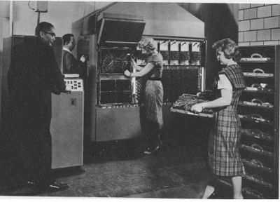
Vacuum Tubes & Plugboards Era
1940s
Notes:
Programmer inserted his/her plugboard into machine

Slide 22
1940s: no operating systems.
  Photo shows Univac 120
  Room-sized computer
  thousands of vacuum tubes
  very slow machines
  No OS
  same group of people designed, built & programmed them in machine language via plugboards - used for math table calculations
  Assembly language developed
Notes:
Vacuum tubes (about the size of a household bulb) contain electronic circuitry that would perform a single logic operation, the equivalent of a transistor
See http://www.nobelprize.org/educational/physics/integrated_circuit/history/index.html for vacuum tubes and transistors

Slide 23
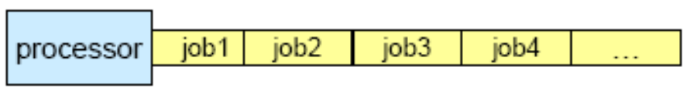
1950s:
  Transistor invented – much more reliable/faster/smaller machines now possible
  First OS for IBM 701 computer (mainframe) by General Motors Research Labs
  http://www-03.ibm.com/ibm/history/exhibits/701/701_intro.html
  One job a time—Single-stream batch-processing systems.
Notes:
Intel Pentium 4 has approx 100,000,000 transistors
Batch processing is execution of a series of programs ("jobs") on a computer without manual intervention.
Jobs are set up so they can be run to completion without manual intervention. So, all input data are preselected through scripts, command-line parameters, or job control language. This is in contrast to "online" or interactive programs which prompt the user for such input. A program takes a set of data files as input, processes the data, and produces a set of output data files. This operating environment is termed as "batch processing" because the input data are collected into batches of files and are processed in batches by the program.
e.g. Billing may conveniently be performed as a batch-oriented business process
e.g. Payroll run

Slide 24
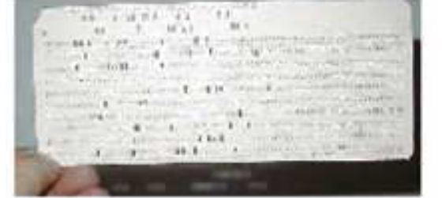
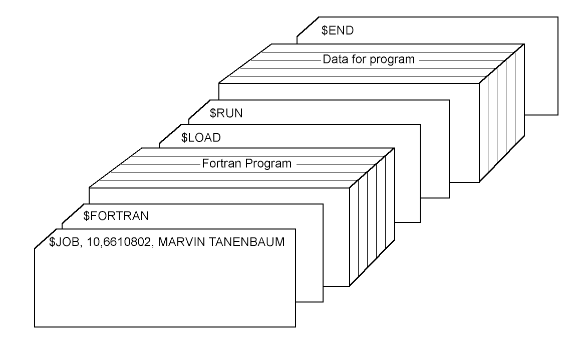
1950s continued..
Batch systems
  Programs written onto punched cards

Slide 25

Early batch system
  (a) bring cards to IBM 1401
  (b) read cards to tape
  (c) and (d) put tape on IBM 7094 which does computing
  (e) and (f) put tape on IBM 1401 which prints output
Notes:
Batching: collect a tray full of jobs in input room, read them onto magnetic tape using 1401
Tape brought into machine room, special program loaded (ancestor of today’s operating system) and program run.
Output put to tape. After each job was finished, the next was job was automatically read in.
When batch was complete tape was removed and brought to 1401 for printing
http://www-03.ibm.com/ibm/history/exhibits/mainframe/mainframe_PP1401.html

Slide 26
1960s & 1970s
  Multiprogramming Systems
    Needed for efficiency
    Single job cannot keep CPU and I/O devices busy at all times
    Multiprogramming organizes jobs (code and data) so CPU always has one to execute
    A subset of total jobs in system is kept in memory
    One job selected and run via job scheduling
    When it has to wait (for I/O for example), OS switches to another job
  More peripheral devices, such as card readers, disk drives, tape drives, printers.
Notes:
OS Features Needed for Multiprogramming
Multiprogramming is the first instance where the OS must make decisions for the users. It is
complex.
• It has the following features:
– Job scheduling – not enough room in memory for all the jobs ready to be brought into memory
– Memory management – the system must allocate the memory to several jobs.
– CPU scheduling – the system must choose when several jobs (from those in memory) are ready to run.
– Resource allocation

Slide 27
1960s & 1970s continued
  Timesharing Systems (multitasking)
    Logical extension of multiprogramming where CPU switches jobs so frequently that users can interact with each job while it is running, creating interactive computing
    Response time should be < 1 second
    Each user has at least one program executing in memory process
    If several jobs ready to run at the same time  CPU scheduling
    If processes don’t fit in memory, swapping moves them in and out to run
    Virtual memory allows execution of processes not completely in memory
    Interactive users communicate with their jobs during execution. (via “dumb terminals”)

Slide 28
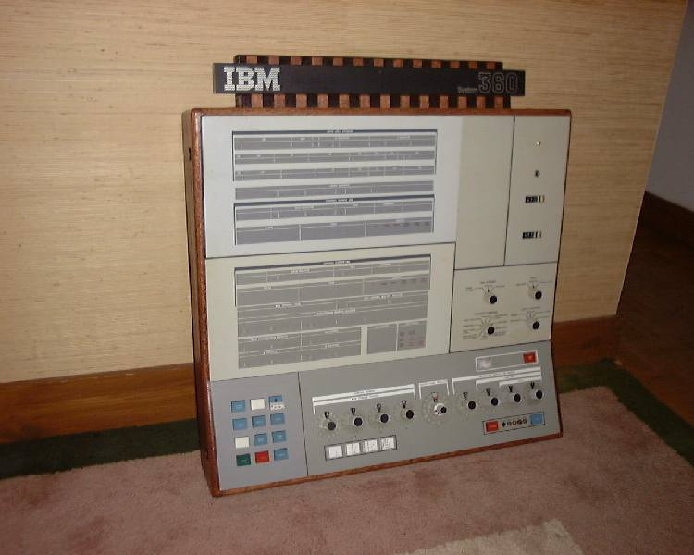
Photo shows a System/360 Model 30
OS called OS/360
OS was huge codewise & buggy - tried to achieve too much
incorporated multiprogramming for the 1st time

Slide 29
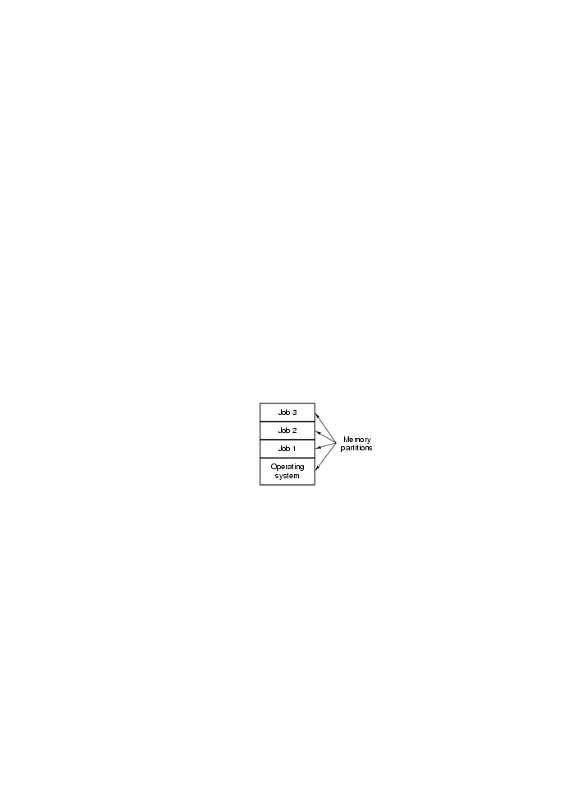
Multiprogramming

Slide 30
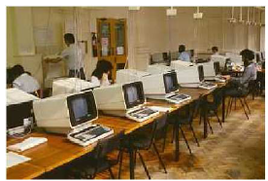
Timesharing system
  multiple terminals into one machine
  each user has illusion of entire machine to him/herself

Slide 31
MIT Multics system (mid-1960’s) was the first large timeshared system
  nearly all OS concepts can be traced back to Multics

Slide 32
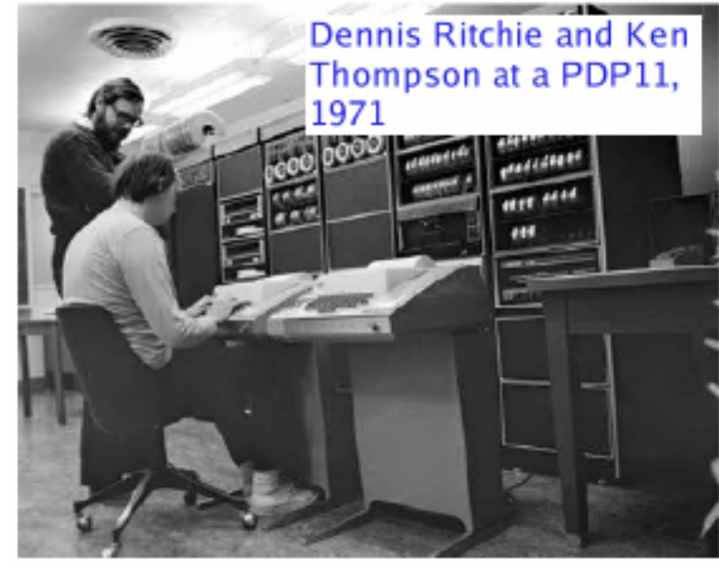
Minicomputers also took off in this era
  DEC PDP-1 in 1961
  “only” $120K - sold well
  series went to PDP-11
  Ken Thompson and Dennis Ritchie (RIP 2011) wrote UNIX OS ( based on MULTICS ) on PDP-7

Slide 33
1980s
  The decade of the PC and the workstation—
    Individuals and small businesses can have their own powerful computer.
  Graphical User Interface (GUI) with mouse provides easy-to-use interface
  Distributed computing (under Client/Server model) is widespread

Slide 34
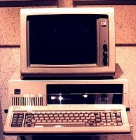
1980s continued..
  Photo shows IBM Model 5150 - one of the first “true” PCs
    Intel 8088 CPU, 4.77MHz, 16K RAM, $3K
Notes:
Current machines have 8GB memory, 1000GB hard drive, run at 3GHz (3,000,000,000 cycles per second)

Slide 35
1980s continued..
  Early microcomputer (or PC) OSs were command-line
  Engelbart had developed the idea of a GUI to work with a mouse
    Xerox PARC adopted these ideas into machines they built but never saw their huge potential

Slide 36
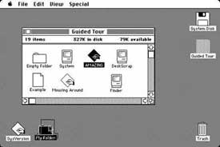
  Steve Jobs (Apple Inventor) visited PARC, realised
  potential of GUI and
  incorporated it
  into the Apple MAC (1984)

Slide 37
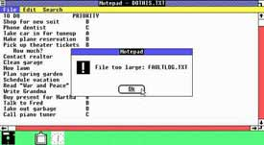
  Windows 1.0 (1985)

Slide 38
Microsoft successor to MS-DOS strongly influenced by Apple MAC success
  called “Windows” - original version (1.0) a GUI program running atop MS-DOS
  considered clumsy/less capable than MAC
  took off with version 3.0

Slide 39
1990s
  Hardware performance continued to improve exponentially.
    Speed — several hundred MIPS (normal PC) Storage — one GB a hard disk
  With the creation of World Wide Web (WWW) and fast internet connections, distributed computing is commonly used between PCs.
    OS support for networking tasks became standard.
    Security threats.
Notes:
The number of MIPS (million instructions per second) is a general measure of computing performance

Slide 40
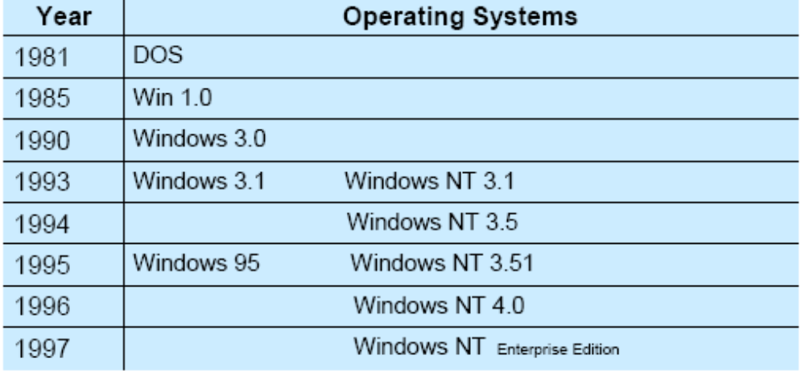
1990s continued..
  Microsoft Corporation became dominant.
  http://windows.microsoft.com/en-US/windows/history

Slide 41
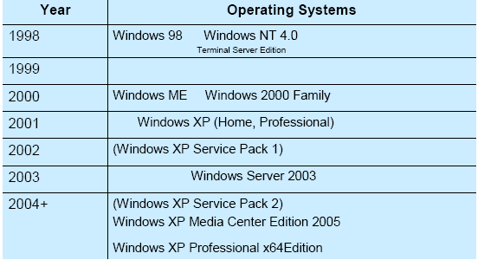
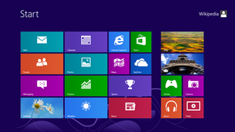
Windows 7 – released in 2008
Windows 8 – released in 2012
To be continued…..

